Slide 1
Subject Name : Database Management System Presentation Title: Big Data
JEPPIAAR INSTITUTE OF TECHNOLOGY
“Self-Belief | Self Discipline | Self Respect”
Department of Computer Science and Engineering
Team Members:
Students Name Reg.No:
1. SARANRAJ.P 210618104044
2. RAHUL.A 210618104037
3. EMMANUEL JOHNSON PAUL 210618104016
4. SANTHOSH KUMAR.M 210618104043
5. RAJESH.V 210618104301
6. GOWTHAM.J 210618104012

Slide 2
Objective
To Design/ Analyze/ Evaluate
Understanding and Targeting Customers: Big data helps an organization understand its customers better, and helps it narrow down the target audience, thus improving their marketing campaign.
Big Data’ is similar to ‘small data’,but bigger in size.
Big data is a field that deals with data sets that are too large or complex to be dealt with by traditional data-processing application software.
Walmart handles more than 1 million customer transaction every hour.
Facebook handles 40 billion photos from its user base.

Slide 3
Volume
A typical have had 10 gigabytes of storage in 2000.
Today, facebook ingests 500 terabytes of new data every day.
Boeing 737 will generate 240 terabytes of flight data during a single flight across the US.

Slide 4
Block Diagram/ Work Flow/ Flow Chart

Slide 5
Velocity
Clickstreams and ad impressions capture user behavior at millions of events per second.
Machine to machine processes exchange data between billions of devices.
Infrastructure and sensors generate massive large data in real time.

Slide 6
Technical Details

Slide 7
Technical Details

Slide 8
Technical Details

Slide 9
VARIETY
Big data isnt just numbers,dates,and strings. Big data is also 3D data,audio and video,and unstructured text,including log files and social media.
Big data analysis includes different types of data.

Slide 10
Result & Discussion

Slide 11
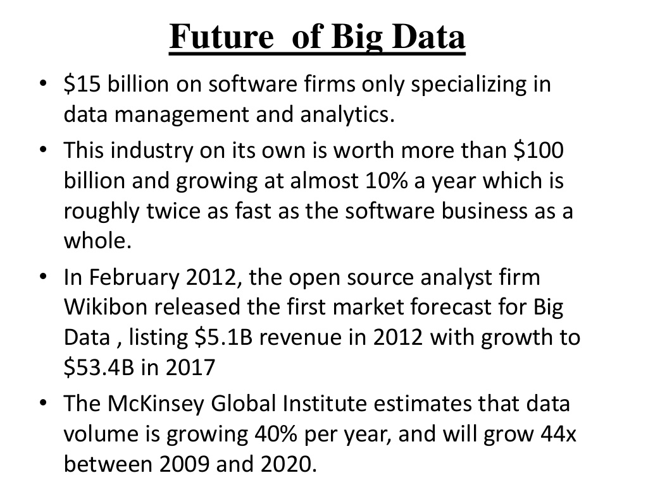
Future Scope

Slide 12
Reference
Linkedin website
Wikipedia

